Slide 1
normalization
Courtesy: Silberschatz Korth and Sudarshan, Ramakrishnan and Gehrke
courses.ischool.berkeley.edu, Pratik Parimal, tutorial point
geeksforgeeks, javapoint Anjali Jivani
Notes:
1

Slide 2
what is normalization?
Normalization is
a process of organizing the data in the database.
used to minimize the redundancy from a relation or set of relations.
used to eliminate the undesirable characteristics like Insertion, Update and Deletion Anomalies.
divides the larger table into the smaller table and links them using relationship.
5NF
4NF
BCNF
3NF
2NF
1NF

Slide 3
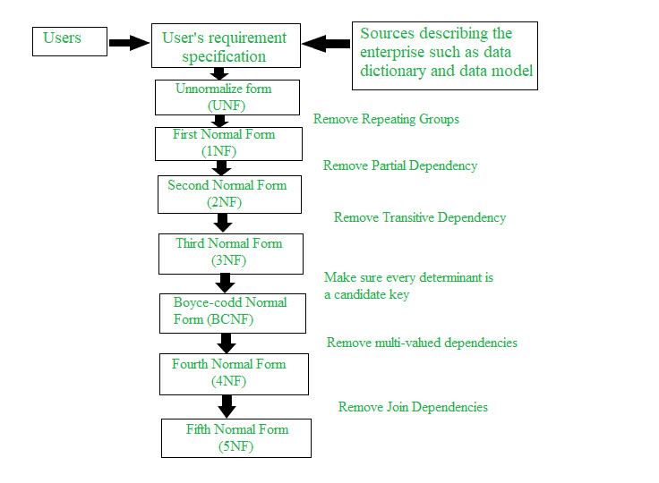
normal forms

Slide 4
functional dependencies
Functional dependencies (FDs) are used to specify formal measures of the "goodness" of relational designs.
FDs and keys are used to define normal forms for relations.
FDs are constraints that are derived from the meaning and interrelationships of the data attributes.
Definition:
A set of attributes X functionally determines a set of attributes Y if the value of X determines a unique value for Y.
e.g. empno → sal, passportno → name, rollno → birthdate,
empno,ename → sal,comm
For a value of LHS, only one value for RHS.
e.g. sal → empno (is not a functional dependency)
5000 → many employee numbers, so not a FD.

Slide 5
functional dependencies
X → Y holds if whenever two tuples have the same value for X, they must have the same value for Y.
If t1[X]=t2[X], then t1[Y]=t2[Y] in any relation instance r(R)
e.g. if sal → comm is a FD, then two people having the same salary will have the same commission.
e.g. Project Number determines project name and location
PNUMBER → {PNAME, PLOCATION}
e.g. EMPNO and project number determines the hours per week that the employee works on the project
{EMPNO, PNUMBER} → HOURS
X → Y in R specifies a constraint on all relation instances r(R)
FDs are derived from the real-world constraints on the attributes

Slide 6
functional dependencies
X → Y holds, X is called the determinant.
If K is a key of R, then K functionally determines all attributes in R (since we never have two distinct tuples with t1[K]=t2[K])
i.e. empno → ename,hiredate,sal,comm,job,deptno (empno is key)
e.g. empno → hiredate
empno,ename → hiredate (hiredate actually is not dependent on
both)
This is called partial dependency.
e.g. seatno,subno → marks_obt (marks_obt depends on both the
attributes)
This is called Fully Functionally Dependent (FFD).
A trivial dependency X → Y is one where Y is a subset of X.
e.g. seatno,subno → subno

Slide 7
inference rules of fds
Given a set of FDs F, we can infer additional FDs that hold whenever the FDs in F hold
Armstrong's inference rules (Armstrong’s Axioms)
A1. Reflexive - If Y is a subset-of X, then X → Y
e.g. empno,ename → ename, empno → empno
A2. Augmentation - If X → Y, then XZ → YZ (Notation: XZ stands for X U Z)
e.g. if empno → sal
then empno,ename → sal,ename
A3. Transitive - If X → Y and Y → Z, then X → Z
e.g. if empno → sal and sal → comm
then empno → comm
A1, A2, A3 form a sound and complete set of inference rules
sound (generate only functional dependencies that actually hold) and
complete (generate all functional dependencies that hold).
There are three other rules which are derived from these basic rules.

Slide 8
additional inference rules
Armstrong's inference rules (Armstrong’s Axioms)
A1. Reflexive - If Y is a subset-of X, then X → Y
A2. Augmentation - If X → Y, then XZ → YZ
A3. Transitive - If X → Y and Y → Z, then X → Z
Additional Armstrong’s Axioms:
A4. Decomposition - If X → YZ, then X → Y and X → Z
e.g. if empno → ename,sal then
empno → ename and empno → sal
A5. Union - If X → Y and X → Z, then X → YZ
e.g. if empno → ename
and empno → sal
then empno → ename,sal
A6. Psuedotransitivity - If X → Y and WY → Z, then WX → Z
e.g. if empno → sal
and sal,comm → netpay
then empno,comm → netpay
Closure of a set F of FDs is the set F+ of all FDs that can be inferred from F
GoToSlide38

Slide 9
the 1st normal form
Normal form: Condition using keys and FDs of a relation to certify whether a relation schema is in a particular normal form.
The First Normal Form says that a relation is in the 1NF iff :
The domain of each attribute contains only atomic values, and
The value of each attribute contains only a single value from that domain.
There should not be repeating groups.
e.g.
1NF
Mem_ID | Borrowed book
C45 | B33
C45 | B44
C45 | B55
C12 | B56
Mem_ID | Borrowed books
C45 | B33, B44, B55
C12 | B56
Not in 1NF

Slide 10
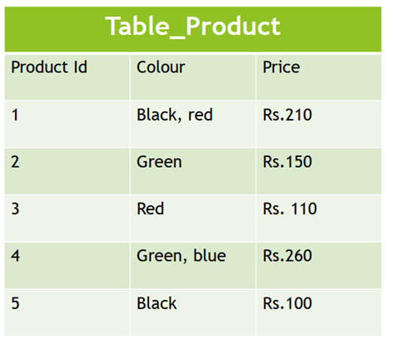
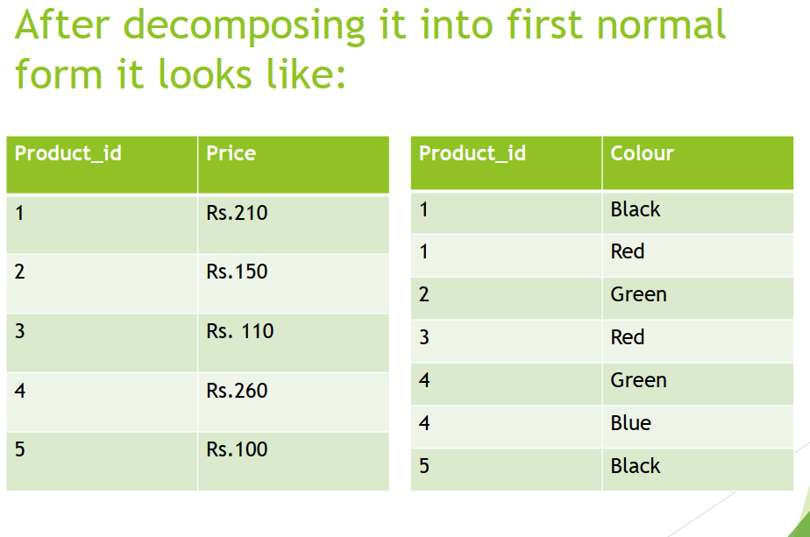
the 1st normal form
This table is not in first normal form because the “Colour” column contains multiple Values.
First normal form enforces these criteria:
Eliminate repeating groups in individual tables.
Create a separate table for each set of related data.
Identify each set of related data with a primary key.
Notes:
student(rollno, name, phone, birthdate, hobbies, deptno)
phone and hobbies are not atomic

Slide 11
the 2nd normal form
The Second Normal Form says that a relation is in the 2NF iff :
The relation should be in 1NF
Every non-key (non-prime) attribute is fully functionally dependent on each candidate key. (That is, we don’t have any partial functional dependency.)
OR
A table is said to be in 2NF if both the following conditions hold:
Table is in 1NF (First normal form)
No non-prime attribute is dependent on the proper subset of any candidate key of table.
An attribute that is a part of one of the candidate keys is known as prime attribute.
An attribute that is not part of any candidate key is known as non-prime attribute.

Slide 12
the 2nd normal form
SNO | PNO | SNAME | SADDR | PRICE
S1 | P1 | ACCENTURE | AKOTA | 78
S1 | P2 | ACCENTURE | AKOTA | 50
...
S2 | P1 | EDUSOFT | ALKAPURI | 67
S2 | P4 | EDUSOFT | ALKAPURI | 45
Candidate key is SNO+PNO
SNO,PNO → SNAME,SADDR,PRICE
The table is in 1NF
Partial dependency:
SNAME and SADDR depend only on SNO
Table is not in 2NF
What are the anomalies?
Insertion Anomaly: Cannot insert new supplier details till supplier supplies a part
Updation Anomaly: If supplier address changes, have to change multiple records
Deletion Anomaly: Assume a supplier is supplying only one part e.g. S1 is supplying only part P2. If for some reason S1 stops supplying P2, removing this record would result in loosing information about S1 too.
2NF:
Split the table: SUPPLIER(SNO,SNAME,SADDR), SUPPLY(SNO,PNO,PRICE)
Anomalies resolved:
Insertion: Can insert new supplier anytime in SUPPLIER table
Updation: Only one record to be updated if address changes
Deletion: If S1 stops supplying P1, a record deleted from SUPPLY table, S1 details remain.

Slide 13
the 2nd normal form
Seatno | Sno | Name | Bdate | Subname | Maxmarks | Passmarks | Marks_obt
Seatno | Name | Bdate
Sno | Subname | Maxmarks | Passmarks
Seatno | Sno | Marks_obt
Check for 2NF only if the key is concatenated. (Else FFD will not occur)

Slide 14
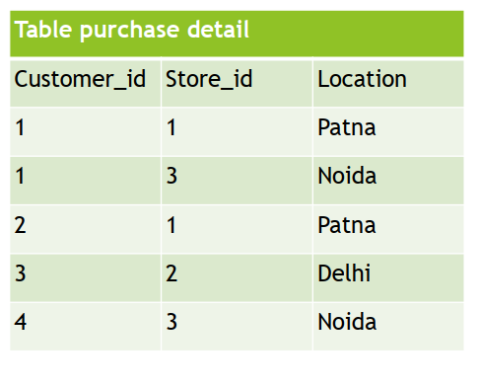
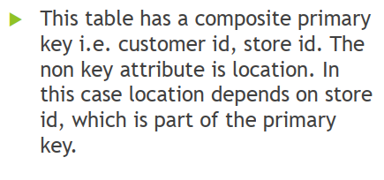

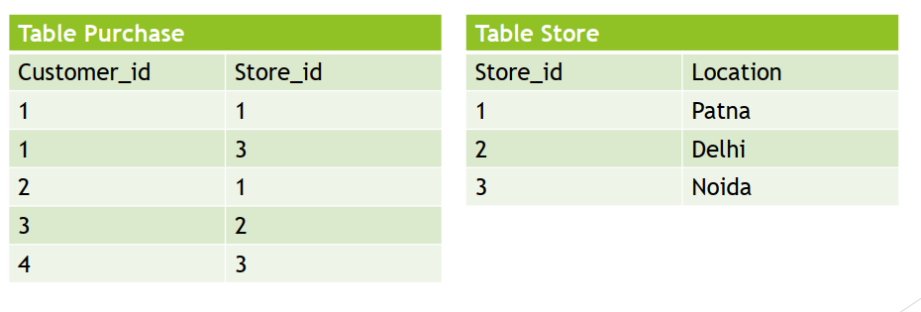
the 2nd normal form

Slide 15
the 3rd normal form
The Third Normal Form says that a relation is in the 3NF iff :
The Relation must be in 2NF
Transitive functional dependency of non-prime attribute on any candidate key should be removed.
OR
A table is in 3NF if,
It is in 2NF
All non-prime attributes are non-transitively dependent on every candidate key. i.e.
Basically, if A → B and B → C then A → C should not exist if A is a candidate key and B and C are non-prime.
Check for 3NF only if there are at least two non-prime attributes. (Else transitivity will not occur)

Slide 16
the 3rd normal form
Empno | Ename | Sal | Job | ProjNo | Comp_dt | Comm | Deptno
Conditions:
Every employee works on only one project.
Every project has a completion date
FDs based on the conditions:
empno → projno
projno → comp_dt
⸫ empno → compl_dt (transitivity)
Is this relation in the 3NF?
Relation is in 2NF as there are no concatenated keys (first condition satisfied)
Transitivity present (second condition not satisfied)
Relation is not in 3NF.
What are the anomalies?
Insertion Anomaly: Cannot insert new project details till an employee works on it.
Updation Anomaly: If completion date of a project changes, have to change multiple records.
Deletion Anomaly: Assume a project has only one employee working on it. If that employee leaves, removing the employee record would result in loosing information about the project too.

Slide 17

the 3rd normal form
Every employee works on only one project.
Empno | Ename | Sal | Job | ProjNo | Comp_dt | Comm | Deptno
Empno | Ename | Sal | Job | Comm | Deptno | ProjNo
ProjNo | Comp_dt
3NF:
Split the table: EMP(EMPNO,ENAME,SAL,JOB,COMM,DEPTNO,PROJNO), PROJECT(PROJNO,COMP_DT)
Anomalies resolved:
Insertion: Can insert new project anytime in PROJECT table
Updation: Only one record to be updated if compl_dt changes
Deletion: Even if emp leaves, project details remain.

Slide 18
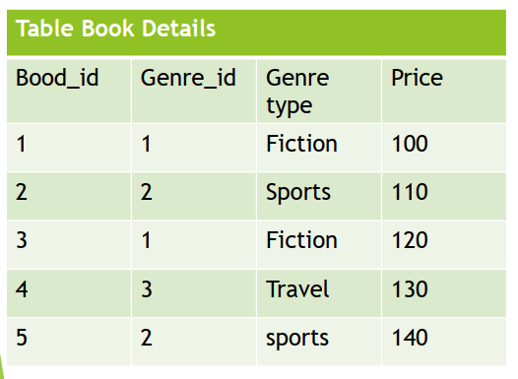
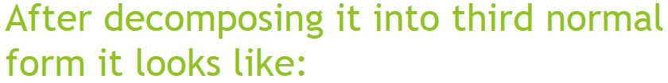
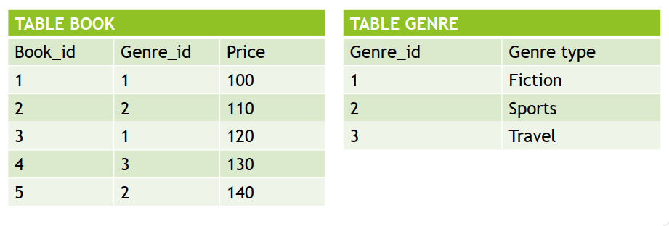
the 3rd normal form
In the given table there is transitivity.
Book_id → Genre_id
Genre_id → Genre_type
⸫ Book_id → Genre_type
Table is not in the 3rd Normal Form.
y

Slide 19
the boyce codd normal form (BCNF)
A table is in BCNF if,
It is in the 3NF and,
for every functional dependency X → Y, X is the super key of the table i.e. X cannot be non-prime if Y is prime.
‘A relation is in BCNF, if and only if, every determinant is a candidate key.’
A 3NF relation is NOT in BCNF if:
Candidate keys in the relation are composite keys (they are not single attributes)
There is more than one candidate key in the relation, and
The keys are not disjoint, that is, some attributes in the keys are common

Slide 20
BCNF
For the college enrollment table given on the RHS, the FDs are:
One student can enrol for multiple subjects.
For each subject, a professor is assigned to the student.
And, there can be multiple professors teaching one subject like we have for Java.
One professor can teach only one subject
Primary key??
Case 1.
student_id + subject → professor
or
Case 2.
student_id + professor → subject
student_id | subject | professor
101 | Java | P.Java1
101 | C++ | P.Cpp
102 | Java | P.Java2
103 | C# | P.Chash
104 | Java | P.Java1
Case 1.
student_id + subject → professor
but, professor → subject
i.e. non-prime identifies prime
or
Case 2.
student_id + professor → subject
(Better option)

Slide 21
BCNF
student_id | subject | professor
101 | Java | P.Java
101 | C++ | P.Cpp
102 | Java | P.Java2
103 | C# | P.Chash
104 | Java | P.Java
student_id | professor
101 | P.Java1
101 | P.Cpp
102 | P.Java2
103 | P.Chash
104 | P. Java1
professor | subject
P.Java1 | Java
P.Cpp | C++
P.Java2 | Java
P.Chash | C#

Slide 22
the boyce codd normal form (BCNF)
Consider a relation R(A,B,C,D) with FDs
A→BCD (1)
BC→AD (2)
D→B (3)
Find the key(s) and normal form.
A→A (4) reflexivity
A→ABCD from (1), (4), union, A is the key
BC→ABCD (2), reflexivity, union, BC is key
R(A BC D)
Only one non-prime attribute, no transitivity, so it is in 3NF.
But from (3), D→B, non-prime attribute identifies prime attribute. So relation is not in BCNF.
So split the table,
R1 (A, D, C)
R2 (D, B)
Notes:
property(pid, district, lotno, area, price, tax)
For every district, lotno starts from 1
Price depends on area
tax depends on district
Keys: pid and district+lotno
FDs: area → price (1)
district → tax (2)
property(pid, district, lotno, area, price, tax) – 2 candidate keys
it is 1NF
Not in 2NF because of (2) – partial dependency
property(pid, district, lotno, area, price), taxdetails(district, tax) - In 2NF now
Not in 3NF because of (1) – transitivity present
property(pid, district, lotno, area), Pricetable(area, price) – In 3NF now
Final normalized tables(upto 3NF):
property(pid, district, lotno, area)
Pricetable(area, price)
taxdetails(district, tax)
If according to the data available we find that if area is,
500, 1500, 2500, etc. district is Abad
1000, 2000, 3000, etc. district is Surat
200, 1200, 2200, etc. district is Vda
i.e FD now is area → district
In table-1, non-prime identifies prime attribute so relation is not in BCNF.
Split the table-1,
property(pid, district, lotno, area) into –
4. property(pid, lotno, area)
5. areatable(area, district)
We can join table-2 and table-5 (denormalization)
a_p_table(area, price, district)
Final tables after normalizing till BCNF:
property(pid, lotno, area)
taxdetails(district, tax)
a_p_table(area, price, district)

Slide 23
the 4th normal form
Empno | Projno | dependent
101 | P1 | D1
101 | P2 | D2
101 | P1 | D3
102 | P5 | Dnull
Any relation is in Fourth Normal Form if it is BCNF and any multivalued dependencies are trivial
Eliminate non-trivial multivalued dependencies by projecting into simpler tables
e.g. one employee can work on many projects and one employee can have zero or more dependents
Empno | Projno
101 | P1
101 | P2
102 | P5
… | …
Empno | dependent
101 | D1
101 | D2
101 | D3
… | …
Notes:
trivial dependency – FDs that include the LHS on the RHS.
A trivial functional dependency is a database dependency that occurs when you describe a functional dependency of an attribute or of a collection of attributes that includes the original attribute.

Slide 24
the 4th normal form
Empno | Projno | dependent
101 | P1 | D1
101 | P2 | D2
101 | P1 | D3
102 | P5 | Dnull
Empno | Projno
101 | P1
101 | P2
102 | P5
… | …
Empno | dependent
101 | D1
101 | D2
101 | D3
… | …
What are the anomalies?
Insertion Anomaly: To insert a project for an employee, a dependent is required and to insert a dependent project is required .
Updation Anomaly: If a project number changes, multiple records to be changes. e.g. if P1 changes to P6 for empno 101, then two records to be updated.
Deletion Anomaly: If an employee stops working on a project, deleting that record could result in losing information about the dependent and vice-versa. E.g. if 101 stops working on P1, deleting that record results in deleting information about D1 and D3.

Slide 25
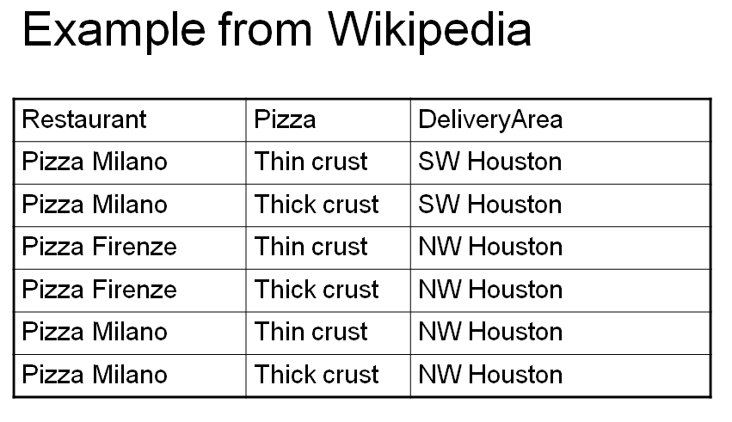
the 4th normal form
The table has no non-key attributes
Key is { Restaurant, Pizza, DeliveryArea}
Two non-trivial multivalued dependencies
Restaurant → → Pizza
Restaurant → → DeliveryArea
since each restaurant delivers the same pizzas to all its delivery areas

Slide 26
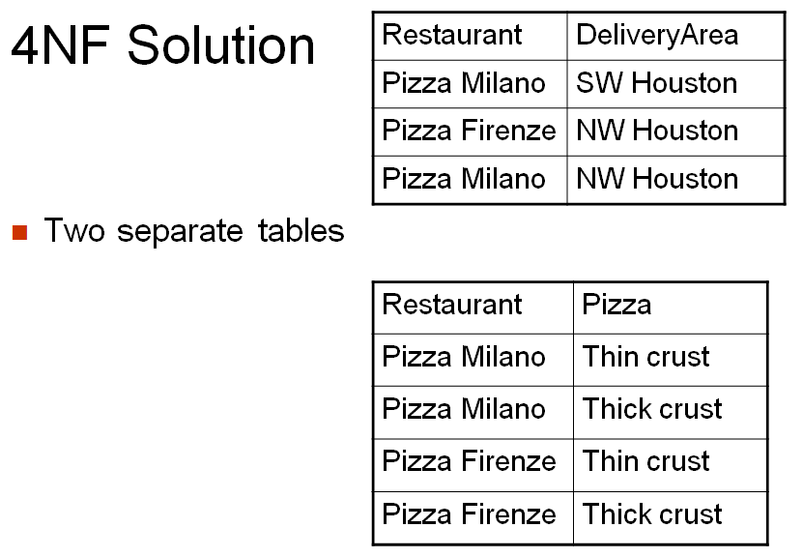
the 4th normal form

Slide 27
the 5th normal form
A relation is in 5NF if every join dependency in the relation is implied by the keys of the relation
Implies that relations that have been decomposed in previous normal forms can be recombined via natural joins to recreate the original relation.
Also called the Project-Join Normal form
SNO | PNO | JNO
SNO | PNO
PNO | JNO
JNO | SNO
Top down is projection and bottom up is join
Split the table in such a way that a natural join on the bottom relations gives the original top relation

Slide 28
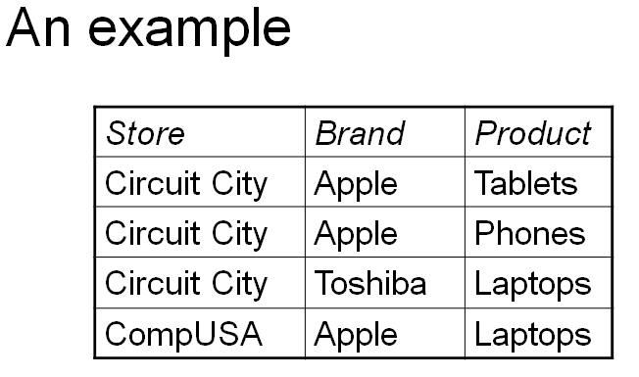
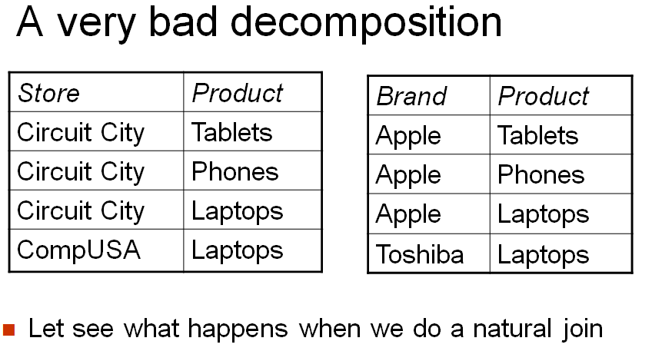
the 5th normal form
Note that Circuit City sells Apple tablets and phones but only Toshiba laptops

Slide 29
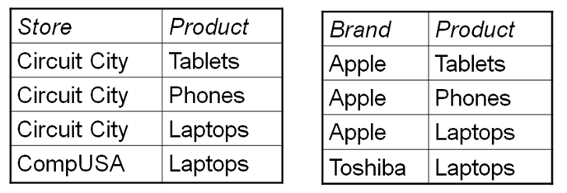
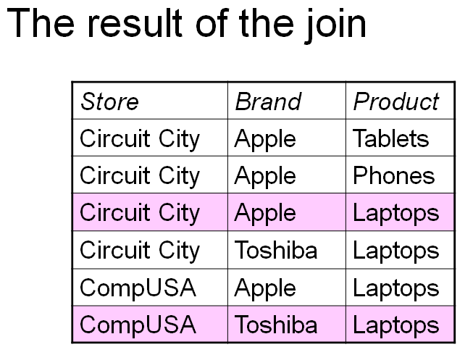
the 5th normal form
Introduces two spurious tuples (Extra)

Slide 30
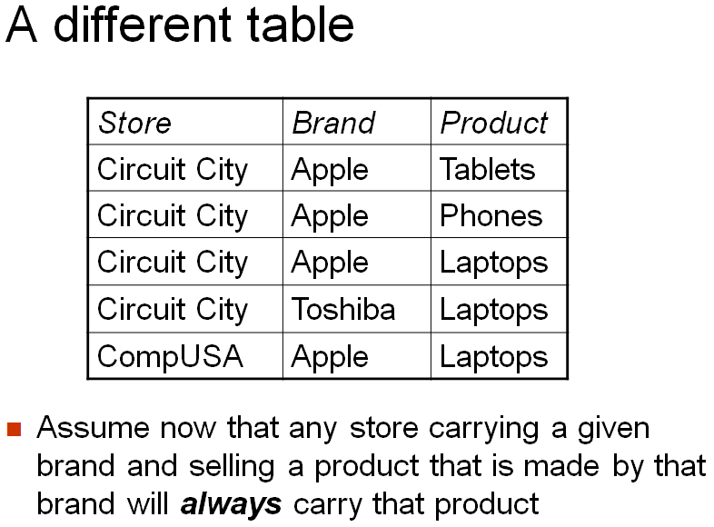
the 5th normal form

Slide 31
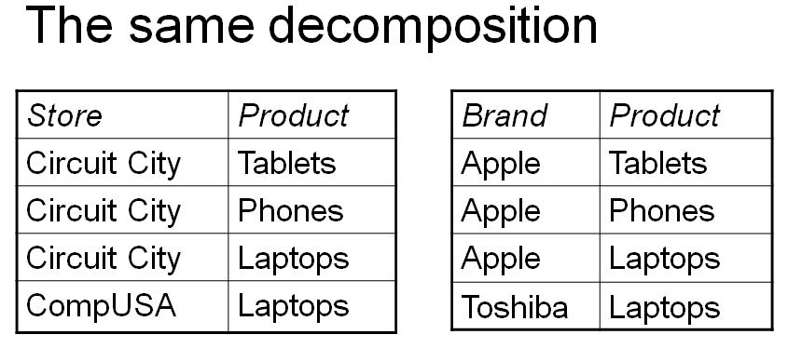
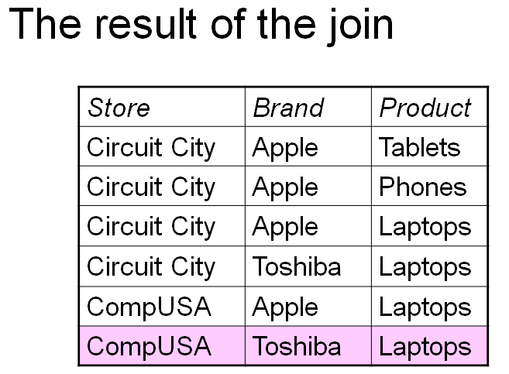
the 5th normal form
Let see what happens when we do a natural join:
Still one spurious tuple

Slide 32
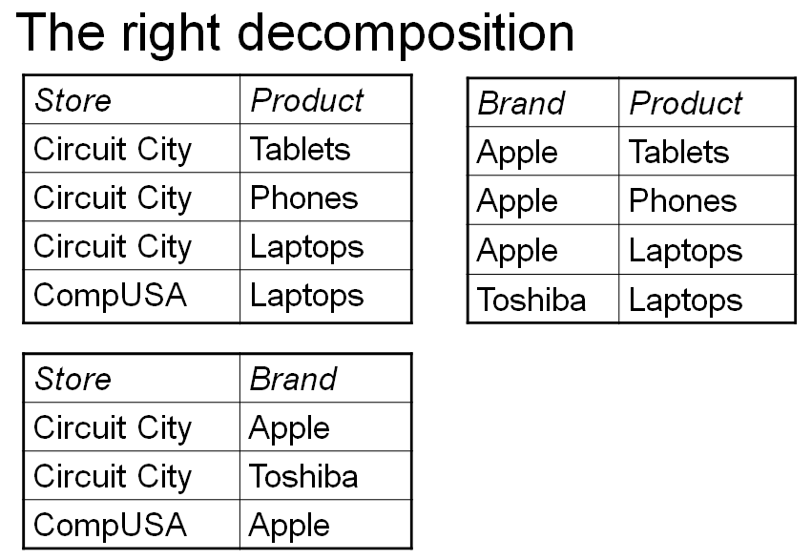
the 5th normal form
The first "big" table was 5NF
A natural join between these three tables will give the original one

Slide 33
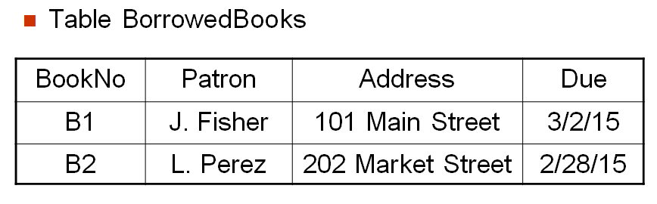
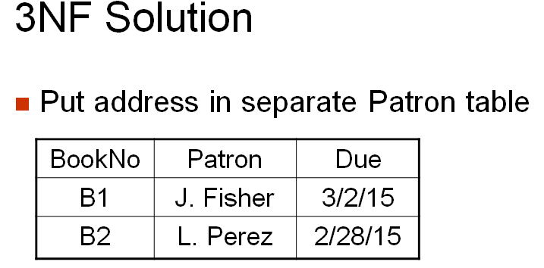
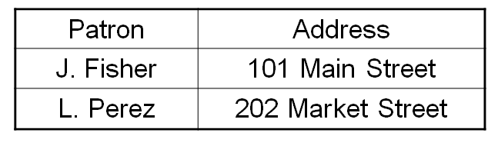
examples
Candidate key?
BookNo
Patron → Address
Transitivity present

Slide 34
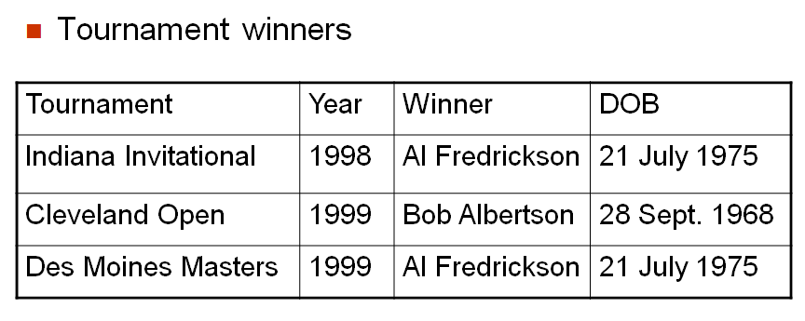
examples
Key is {Tournament, Year}
Normal Form??
It is in 1NF
All non-prime attributes – Winner and DOB depend on the whole key (FFD)
It is in 2NF
Winner → DOB
Not in 3NF
Tournament, Year → Winner
Winner → DOB
Tournament, Year →DOB (Transitivity)
Tournament_Winner(Tournament, Year, Winner)
Winner_details(Winner, DOB)
3NF

Slide 35
examples
Consider a relation R(A,B,C,D,E) with FDs
A→BCDE (1)
BC→ADE (2)
D→E (3)
Find the key(s) and normal form. Armstrong
A→A (4) reflexivity
A→ABCDE from (1), (4), union, A is the key
BC→ABCDE (2), reflexivity, union, BC is key
R(A BC DE)
From (3), there is transitivity hence it is not in 3NF.
BC is key and all the rest are fully functionally dependent on both, hence relation is in 2NF.
Consider a relation R(city,street,zip) or R(C,S,Z) and FDs,
CS→Z (1)
Z→C (2)
Find the key(s) and normal form.
CS→CS (3) reflexivity
CS→CSZ (4) from (1), (3), union CS is a key
ZS→CS (5) from (2), augmentation
ZS→CSZ from (5), (4), transitivity ZS is a key
There are no non-prime attributes so it is in 3NF. (Not in BCNF)

Slide 36
examples
Consider the relation R(ABCDEFGHIJ) and FDs are:
AB→C (1)
A→DE (2)
B→F (3)
F→GH (4)
D→IJ (5)
---------------------------------------------------------------------
AB→ABC (6) from reflexivity, (1)
AB→ABCDE (7) from (2), (6) union (AB→A and A→DE, so AB→DE)
AB→F (8) from (6), (3), transitivity
AB→GH (9) from (8), (4), transitivity
AB→IJ (10) from (7), (5), transitivity
AB→ABCDEFGHIJ from (7),(8),(9),(10), union AB is the key
----------------------------------------------------------------------
R(ABCDEFGHIJ)
A→DE (2), which means D and E depend on only A and not AB (not FFD)
So R is not in 2NF.
R is in 1NF.

